Slide 1
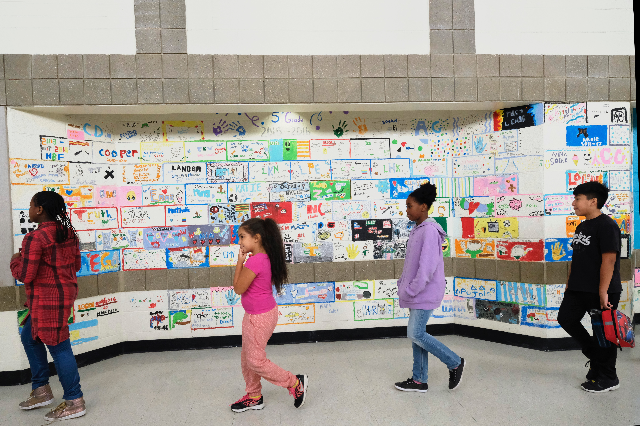

Guns Can’t: A Social Approach to School Safety
Council of Great City Schools
July 12, 2019

Slide 3
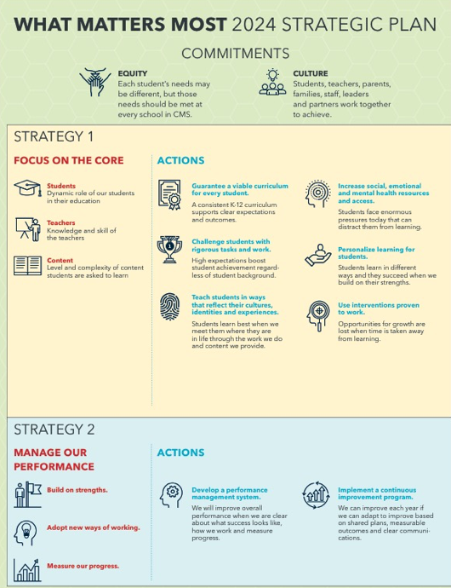
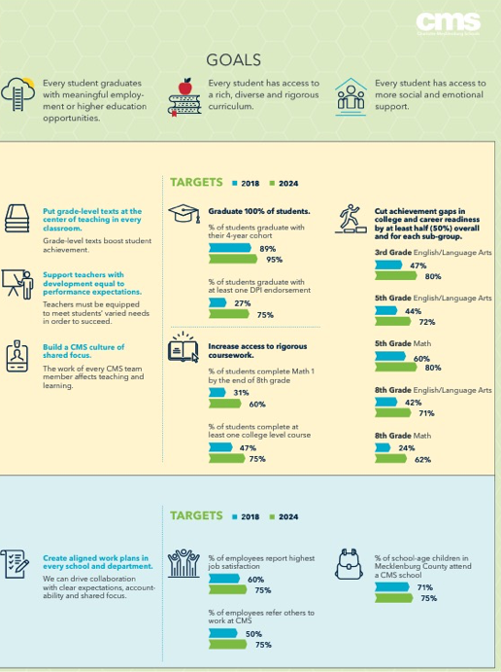
What Matters Most
2024 CMS Strategic Plan
Notes:
WILL REPLACE THIS VISUAL

Slide 4
Rising gun violence in community
Tragedy at Butler High School
Community concerned
A range of responses and actions
Mental health is key
Context

Slide 5
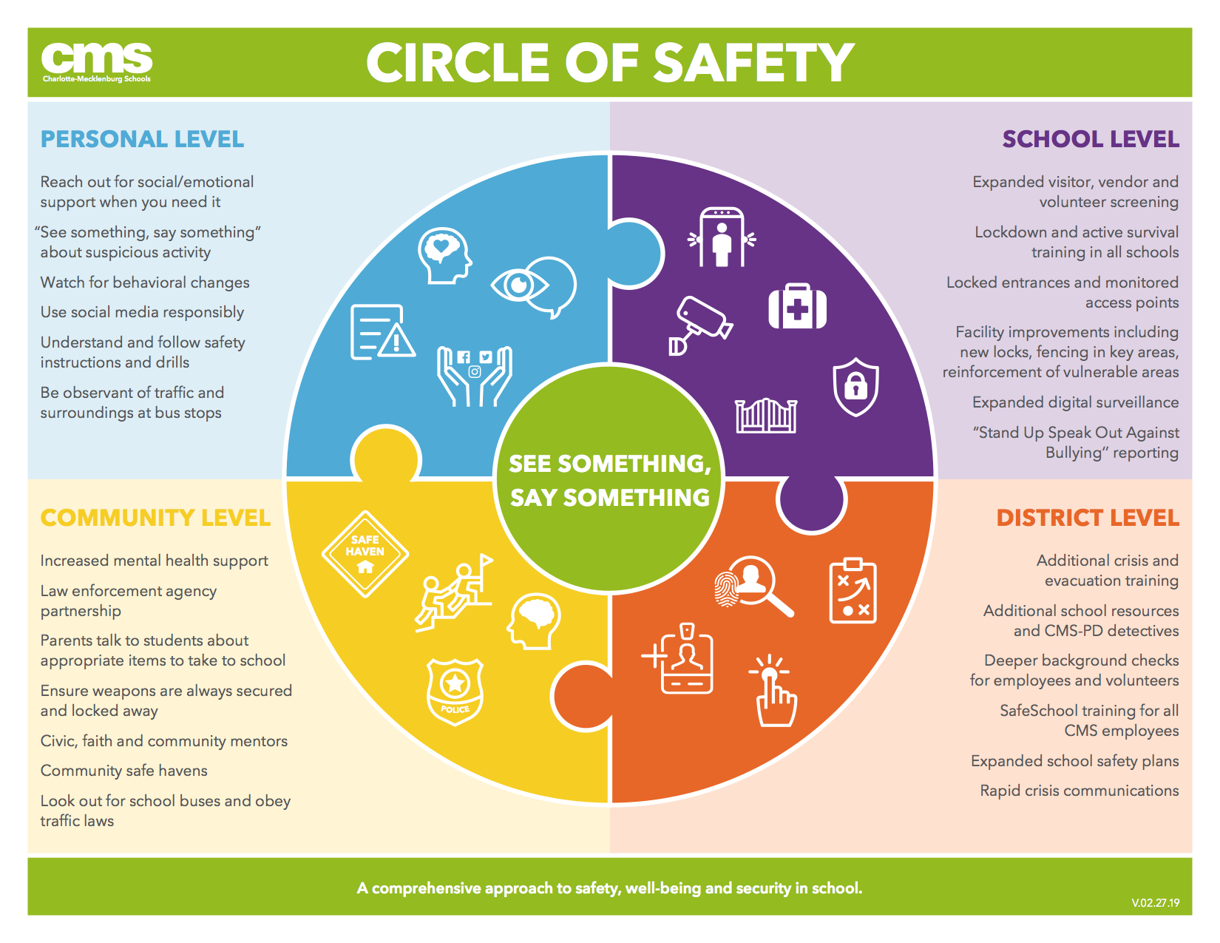
s
Positioning

Slide 6
Is that it?

Slide 7
About culture change
Not “to” but “with” and “of”
Interactive
Creating rather than obeying
Emphasis on empowerment
Primarily digital to reach scale
Focus on students
Friendly
Fun
A social
approach

Slide 8
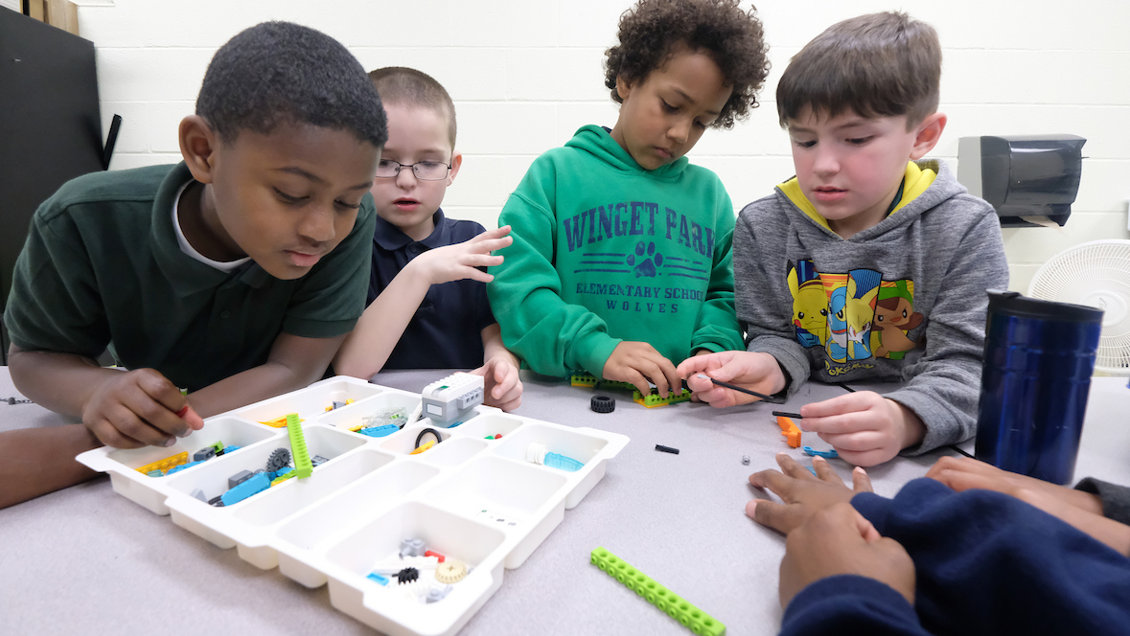
We are
social
beings.
Why

Slide 9
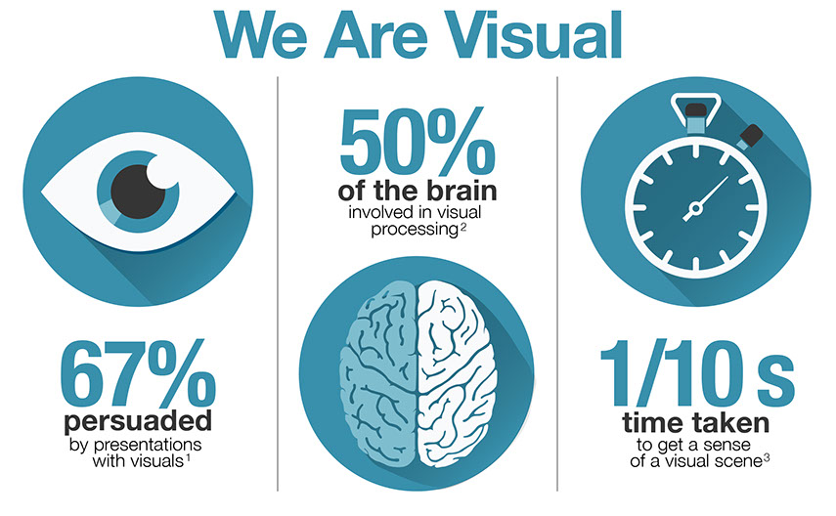
Why

Slide 10
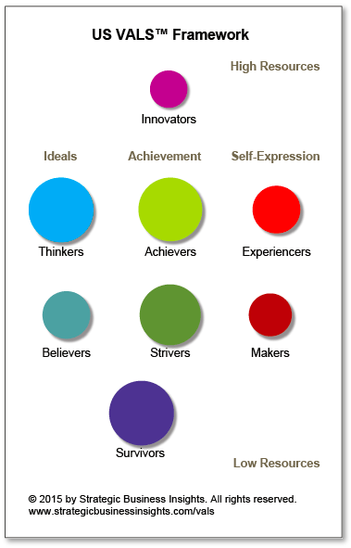
We make decisions based on values.
VALS segments US adults into eight distinct types—or mindsets—using a specific set of psychological traits and key demographics that drive consumer behavior.
Why

Slide 11
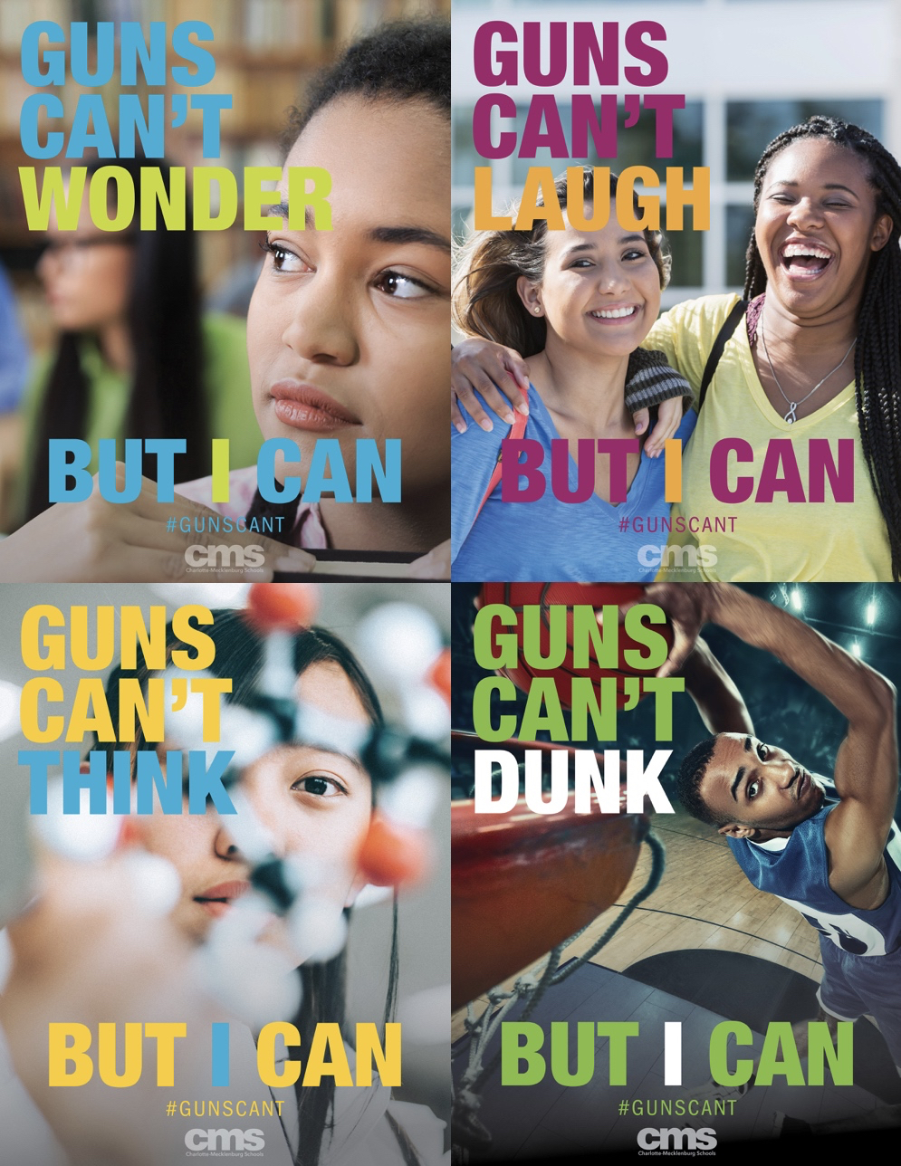
Guns
Can’t

Slide 12
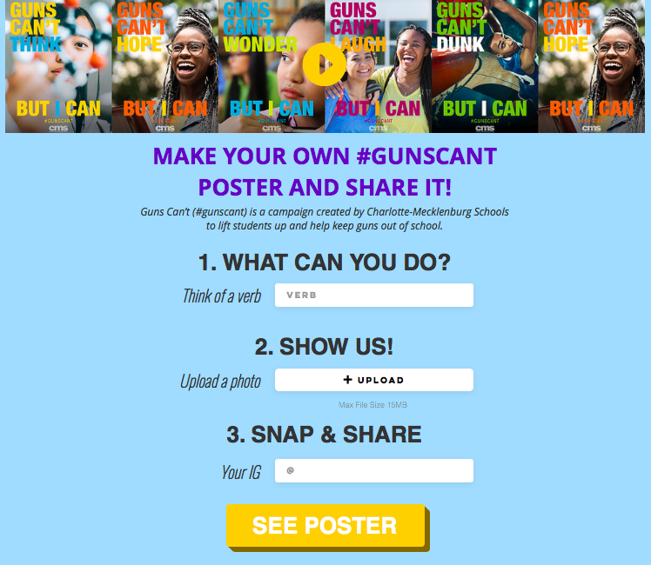
Guns
Can’t
charmeckschools.com/gunscant

Slide 13
Let students lead
Careful about student images
Be real about the impact
Let it emerge rather than pop
Test, test, test
Expect a long timeline
Lift up context with other efforts
Lessons

Slide 14

Notes:
Guns Can’t
CMS has implemented a series of measures this year to further strengthen the Circle of Safety including deeper investments in social, emotional and mental health, safety screenings, technology upgrades, hardware, crisis alert systems and facilities improvements. We will keep investing in and improving these measures moving forward because they are all part of a comprehensive set of actions needed.
But as CMS has stated repeatedly, the most effective solutions to violence, to keeping weapons out of schools and to enabling our staff and students to focus on teaching and learning are solutions that support students mental health, build community and create trust based on shared values.
Some things more fundamental than locks have to be changed to change the fact that gun violence has taken too many students lives in our schools across the nation and most recently on one of our campuses at CMS.
We have to change hearts and minds if we want to do everything we can to keep our schools safe. Our values must be put into action and we have to share that we believe that our students CAN DO amazing things in life if we believe in them, prepare them well and help keep gun violence out of their lives and away from their schools.
So today, CMS is launching Guns Can’t, a social campaign that will add to the district’s Circle of Safety efforts to help keep weapons out of our schools and protect the lives of students and staff.
Guns Can’t is a call for reducing gun violence in schools coming from the voices of those who want change most – our students and staff, families, friends and community members whose lives have been affected and are at risk because of gun violence in schools.
Guns Can’t represents a new approach to help keep weapons out of our schools while lifting up the abilities, potentials and achievements of students.
Guns Can’t is based on a simple idea – gun violence in schools stands in the way of students who can make the most of their talents, skills and abilities in safe schools.
This idea is conveyed in simple pictures and words (see samples below) brought together in images that can be shared across our community, with each other and with everyone who believes in what students CAN DO.
We have three goals with the Guns Can’t effort
Help keep weapons out of our schools and reduce gun violence on our campuses.
Lift up students’ power to achieve and their talents, skills and potentials in safe schools.
Invite the participation of everyone to help keep weapons out of our schools and reduce school gun violence together.
How it works
CMS will share Guns Can’t images that anyone can use to share or, even better, use as inspiration to create and share their own Guns Can’t poster on social media or print.
The Guns Can’t generator will empower anyone to create their own Guns Can’t poster for sharing and invite others to do the same at https://www.charmeckschools.com/gunscant.
First, On the generator, you simply enter a VERB that describes what you CAN DO that reflects your interests, talents, skills and dreams in life.
Then, you upload a picture of yourself in that activity or that represents you to the world.
Next, you enter your Instagram or other account – this helps us know a little bit about you and enables us to share your image on CMS social media.
Finally, the GC generator gives you back a poster image that you can screen capture or download and share through your own networks with your friends and connections on social media. Together, we will show everyone what we CAN DO.
Guns Can’t is a social campaign inspired by hope. It is not a monitoring effort, a new lock or even that hi-tech these days. This is an effort to create awareness that what we really value at school – what matters most – is that our students CAN DO anything they can envision without the violence or weapons in school.
that will grow through the power of participation and awareness.
(note: technical improvements continue to the Guns Can’t generator during the day today.)
Participating in Guns Can’t
The Guns Can’t campaign will be available through CMS social media, the CMS website and at https://www.charmeckschools.com/gunscant.
Participation in Guns Can’t is voluntary for everyone and the images above are offered as ideas to inspire participation.
CMS looks forward to students and other members of our community making their own Guns Can’t images and sharing them.
To build awareness and participation in Guns Can’t, CMS will feature select Guns Can’t images on the district’s social media platforms.
CMS asks everyone who participates in Guns Can’t to exercise good judgement and observe positive social media behaviors in their selection of words and images.
CMS will not lift up Guns Can’t creations that reflect poor or offensive taste in language or image.
We will provide additional Guns Can’t content and resources, including print posters and outreach materials, after today’s launch and look forward to continuing work to keep our students and staff safe in school.
In this work, the voices of students must be heard and listened to. I want to share that students will gather on March 24 to talk about school safety and gun violence (INSERT DETAILS HERE).

